Slide 1
Metaheuristic Algorithms
A brief introduction on the basics you need to know

Slide 2
REFERENCES
Talbi E.-G., 2009. Metaheuristics: from design to implementation, Vol. 74, John Wiley & Sons
Blum C. and Roli A., 2003. Metaheuristics in combinatorial optimization: Overview and conceptual comparison, ACM Computing Surveys, 35(3):268-308
Back T., Hammel U. and Schwefel H.-P., 2002. Evolutionary computation: comments on the history and current state, IEEE Transactions on Evolutionary Computation, 1(1):3-17

Slide 3
INTRODUCTION
Heuristics
“to find” (from ancient Greek “ευρίσκειν”)
Meta-
An abstraction from another concept
beyond, in an upper level
used to complete or add to
E.g., meta-data = “data about data”
Metaheuristics
“A heuristic around heuristics”

Slide 4
INTRODUCTION
Some popular frameworks
Genetic Algorithms
Simulated Annealing
Tabu Search
Scatter Search
Ant Colony Optimization
Particle Swarm Optimization
Iterated Local Search
Variable Neighborhood Search
Adaptive Memory Programming
…

Slide 5
INTRODUCTION
Metaheuristics…
…can address both discrete- and continuous-domain optimization problems
…are strategies that “guide” the search process
…range from simple local search procedures to complex adaptive learning processes

Slide 6
INTRODUCTION
Metaheuristics…
…efficiently explore the search space in order to find good (near-optimal) feasible solutions
…provide no guarantee of global or local optimality
…are agnostic to the unexplored feasible space (i.e., no “bound” information)
…lack a metric of “goodness” of solution (often stop due to an external time or iteration limit)
…are not based on some algebraic model
unlike exact methods!
…are often used in conjunction with an exact method
E.g., use metaheuristic to provide upper bounds
E.g., use restricted MILP as “local heuristic”

Slide 7
INTRODUCTION
Metaheuristics…
…usually are non-deterministic
…usually incorporate mechanisms to avoid getting trapped in confined areas of the search space
…are not problem specific (but their subordinate heuristics are)
…may use some form of memory to better guide the search

Slide 8
INTRODUCTION
Metaheuristics…
…is a relatively new field (started in the ‘80s or so)
becomes possible because we can now afford vast amounts of computation
inspired from “AI,” rather than “pure math”
lack of theoretical “rigor” (no proofs, theorems, etc. for people to pursue)

Slide 9
Introduction
Let’s consider the problem of find the best visiting sequence (route) to serve 14 customers.
How many possible routes exists?
(n-1)!=(15-1)!=14!= 8,7178 X 1010 = 88 billion solutions
If a PC can check about 1 million solution per second, then we need 8,8*1010 routes /106 routes/ sec = 88.000 sec or about 24,44 hours to check them all and find the best!

Slide 10
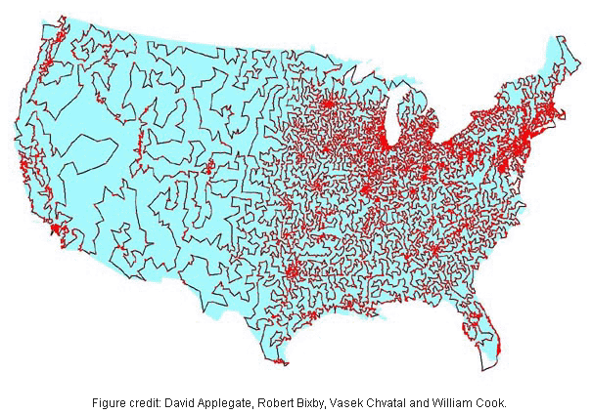
COMBINATORIAL EXPLOSION
13,509-city TSP
19,982.859 mi.
What type of algorithm would you pick to solve a problem with 10^{49,933} feasible solutions?

Slide 11
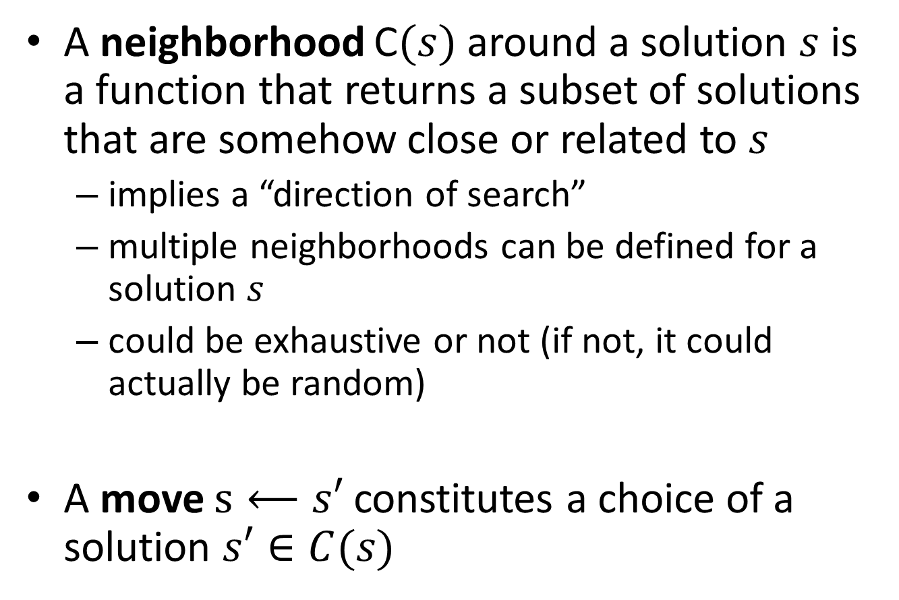
TWO BASIC DEFINITIONS
A neighborhood C$(s)$ around a solution $s$ is a function that returns a subset of solutions that are somehow close or related to $s$
implies a “direction of search”
multiple neighborhoods can be defined for a solution $s$
could be exhaustive or not (if not, it could actually be random)
A move $s⟵s′$ constitutes a choice of a solution $s′∈C(s)$

Slide 12
CLASSIFICATION #1
Based on algorithm “inspiration”
A classification may not be mutually exclusive
Nature
Tabu Search
Non-nature
Genetic Algorithms
Ant Colony Optimization
Iterated Local Search

Slide 13
CLASSIFICATION #2
Based on whether objective changes along algorithm execution
Why would we ever “modify” the objective?
Static objective
Tabu Search
Iterated Local Search
Dynamic objective
Guided Local Search
…

Slide 14
CLASSIFICATION #3
Based on whether they remember (and utilize for future) their search history
Memory can be “short-term” or “long-term”
Using memory
Tabu Search
Memory-less
(“Markov” property)
Simulated Annealing
GRASP
Most NLP local optimization algorithms
Ant Colony Optimization

Slide 15
CLASSIFICATION #4
Based on whether they use multiple types of neighborhoods (“directions of search”)
Depends on what you classify as neighborhood
One neighborhood
Most algorithms
Multiple neighborhoods
Variable Neighborhood Search

Slide 16
CLASSIFICATION #5
Based on whether the search evolves one or multiple solutions
Trend towards population-based methods, with integration of proven ideas from trajectory methods
(single) Trajectory methods
Tabu Search
Population-based methods
Genetic Algorithms
Ant Colony Optimization
Iterated Local Search
Simulated Annealing
Adaptive Memory Programming

Slide 17
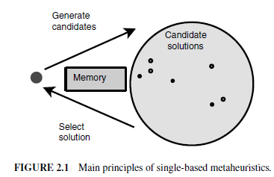
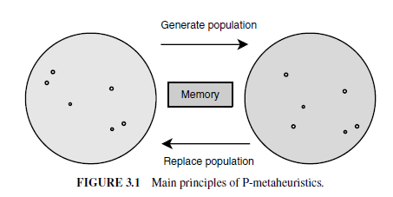
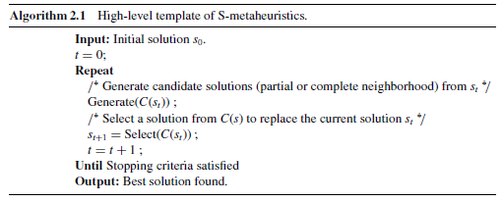
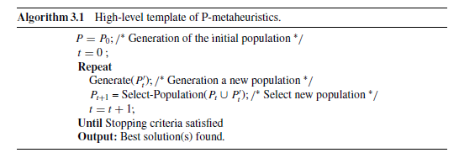
CLASSIFICATION #5
Trajectory
(S-metaheuristics)
Population-based
(P-metaheuristics)

Slide 18
TRAJECTORY METHODS

Slide 19
TRAJECTORY METHODS
C(s₀)
s₀

Slide 20
TRAJECTORY METHODS
C(s₀)
s₀
s₁
C(s₁)

Slide 21
TRAJECTORY METHODS
C(s₀)
s₀
s₁
C(s₁)
s₂
C(s₂)
Stop because of no improvement in region C(s₂)

Slide 22
TRAJECTORY METHODS
C(s₀)
s₀
s₁
C(s₁)
s₂
C(s₂)
Turns out two global optima in this problem, but none was identified
One was missed during search of region C(s₁)
One was far away from searched space

Slide 23
POPULATION-BASED METHODS

Slide 24
POPULATION-BASED METHODS
0th population

Slide 25
POPULATION-BASED METHODS
Get some new points

Slide 26
POPULATION-BASED METHODS
Drop some old points

Slide 27
POPULATION-BASED METHODS
1st population

Slide 28
POPULATION-BASED METHODS
2nd population

Slide 29
POPULATION-BASED METHODS
All points sampled
Again, optimum may or may not have been sampled
Typically, the incumbent always remains in the population, so need only focus on last generation

Slide 30
CLASSIFICATION #5
Trajectory
(S-metaheuristics)
Basic Local Search (3192 BC)
Simulated Annealing (1983)
Tabu Search (1986)
GRASP (1989)
Guided Local Search (1997)
Variable Neighborhood Search (1999)
Iterated Local Search (1999)

Slide 31
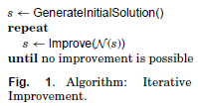
BASIC LOCAL SEARCH
Neighborhood
Improve() can be implemented as “first improvement” or “best improvement” or anything in between

Slide 32
BASIC LOCAL SEARCH
Neighborhood

Slide 33
BASIC LOCAL SEARCH
Neighborhood
Local optimum found, cannot improve!
How to escape the local optimum “trap”?

Slide 34
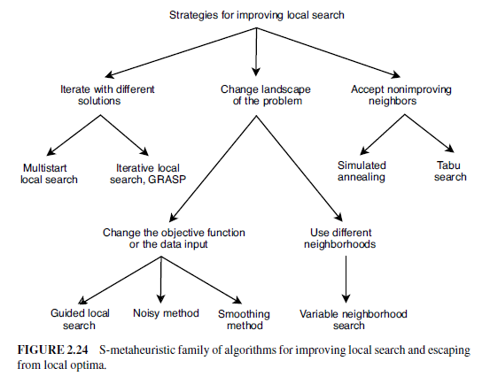
ESCAPING LOCAL OPTIMA

Slide 35
INTENSIFY & DIVERSIFY
Merriam-Webster:
Intensify
to become stronger or more extreme; to become more intense
Diversify
to change (something) so that it has more different kinds of people or things

Slide 36
INTENSIFY & DIVERSIFY
Every metaheuristic aspires to do both
Many have parameters to control this balance
Often, these parameters can be changed dynamically during search
Initially, focus is on diversification; later, on intensification (and cycles back)

Slide 37
INTENSIFY & DIVERSIFY

Slide 38
INTENSIFY & DIVERSIFY

Slide 39
SIMULATED ANNEALING
Annealing (metallurgy): a heat treatment that alters the physical and sometimes chemical properties of a material to increase its ductility and to make it more workable …
… [annealing] is performed by heating the material for a while and then slowly letting it cool to room temperature.

Slide 40
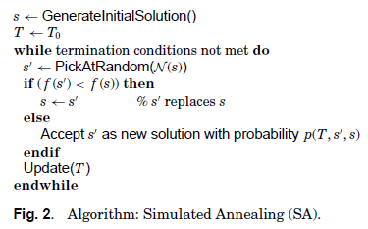
SIMULATED ANNEALING
Parameter T (“temperature”)
initially high
drops as search progresses (hence, the term “annealing”)

Slide 41
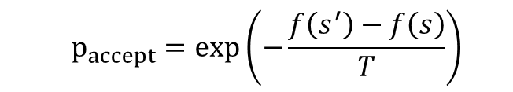
SIMULATED ANNEALING
Move to a random, neighboring solution
if better, accept (always)
if worse, throw a “Boltzmann” dice
$$p_{accept}=exp\left(−\frac{f\left(s^{′}\right)−f\left(s\right)}{T}\right)$$

Slide 42
SIMULATED ANNEALING
How does T affect the trajectory?
what happens at the early stages of the search?
what happens at the late stages of the search?

Slide 43
TABU SEARCH
Taboo (English): prohibited, disallowed, forbidden
Tabu (Fijian): forbidden to use due to being sacred and/or of supernatural powers
…related to similar Polynesian words
tapu (Tongan), tapu (Maori), kapu (Hawaiian)

Slide 44
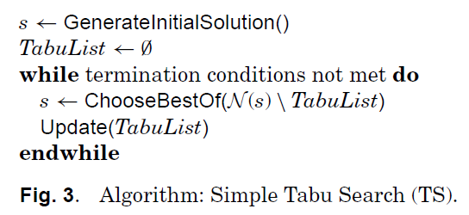
TABU SEARCH
Used mainly for discrete problems
The tabu list constitutes “short-term memory”
Size of tabu list (“tenure”) is finite
Since solutions in tabu list are off-limits, it helps
escape local minima by forcing uphill moves (if no improving move available)
avoid cycling (up to the period induced by tabu list size)
Solutions enter and leave the list in a FIFO order (usually)

Slide 45
TABU SEARCH
Small tenure localizes search (intensification)
Large tenure forces exploration of wider space (diversification)
Tenure can change dynamically during search
Size of tenure is a form of “long-term memory”

Slide 46
TABU SEARCH
Storing complete solutions is inefficient
implementation perspective (storage, comparisons)
algorithm perspective (largely similar solutions offer no interesting information)
Tabu search usually stores “solution attributes”
solution components or solution differences (“moves”)

Slide 47
TABU SEARCH
Asymmetric TSP
Tabu List
(tenure = 3)
Solution Trajectory
A
1
B
A | B | C | D | A
5.5
0.5
2
5
1
1
1.5
D
C
1.5
solution = {tour}
move = {swap consecutive pair}
attributes = {moves}

Slide 48
TABU SEARCH
Asymmetric TSP
Tabu List
(tenure = 3)
Solution Trajectory
A
1
B
A | B | C | D | A
5.5
0.5
2
5
1
1
1.5
D
C
1.5
solution = {tour}
AB
B | A | C | D | B
5.0
move = {swap consecutive pair}
BC
A | C | B | D | A
9.5
attributes = {moves}
CD
A | B | D | C | A
4.0
DA
D | B | C | A | D
4.5

Slide 49
TABU SEARCH
Asymmetric TSP
Tabu List
(tenure = 3)
Solution Trajectory
A
1
B
A | B | C | D | A
5.5
0.5
A | B | D | C | A
4.0
2
5
1
1
1.5
D
C
1.5
solution = {tour}
AB
B | A | C | D | B
5.0
move = {swap consecutive pair}
BC
A | C | B | D | A
9.5
attributes = {moves}
CD
A | B | D | C | A
4.0
DA
D | B | C | A | D
4.5

Slide 50
TABU SEARCH
Asymmetric TSP
Tabu List
(tenure = 3)
Solution Trajectory
A
1
B
A | B | C | D | A
5.5
CD
0.5
A | B | D | C | A
4.0
2
5
1
1
1.5
D
C
1.5
solution = {tour}
move = {swap consecutive pair}
attributes = {moves}

Slide 51
TABU SEARCH
Asymmetric TSP
Tabu List
(tenure = 3)
Solution Trajectory
A
1
B
A | B | C | D | A
5.5
CD
0.5
A | B | D | C | A
4.0
2
5
1
1
1.5
D
C
1.5
solution = {tour}
AB
B | A | D | C | A
5.0
move = {swap consecutive pair}
BD
A | D | B | C | A
4.5
attributes = {moves}
DC
A | B | C | D | A
5.5
CA
C | B | D | A | C
9.5

Slide 52
TABU SEARCH
Asymmetric TSP
Tabu List
(tenure = 3)
Solution Trajectory
A
1
B
A | B | C | D | A
5.5
BD
CD
0.5
A | B | D | C | A
4.0
2
5
1
A | D | B | C | A
4.5
1
1.5
D
C
1.5
solution = {tour}
AB
B | A | D | C | A
5.0
move = {swap consecutive pair}
BD
A | D | B | C | A
4.5
attributes = {moves}
DC
A | B | C | D | A
5.5
CA
C | B | D | A | C
9.5

Slide 53
TABU SEARCH
Asymmetric TSP
Tabu List
(tenure = 3)
Solution Trajectory
A
1
B
A | B | C | D | A
5.5
BD
CD
0.5
A | B | D | C | A
4.0
2
5
1
A | D | B | C | A
4.5
1
1.5
D
C
1.5
solution = {tour}
AD
D | A | B | C | D
5.5
move = {swap consecutive pair}
DB
A | B | D | C | A
4.0
attributes = {moves}
BC
A | D | C | B | A
9.5
CA
C | D | B | A | C
5.0

Slide 54
TABU SEARCH
Asymmetric TSP
Tabu List
(tenure = 3)
Solution Trajectory
A
1
B
A | B | C | D | A
5.5
BD
CD
0.5
A | B | D | C | A
4.0
2
5
1
A | D | B | C | A
4.5
1
1.5
D
C
1.5
solution = {tour}
AD
D | A | B | C | D
5.5
move = {swap consecutive pair}
DB
A | B | D | C | A
4.0
attributes = {moves}
BC
A | D | C | B | A
9.5
CA
C | D | B | A | C
5.0

Slide 55
TABU SEARCH
Asymmetric TSP
Tabu List
(tenure = 3)
Solution Trajectory
A
1
B
A | B | C | D | A
5.5
CA
BD
CD
0.5
A | B | D | C | A
4.0
2
5
1
A | D | B | C | A
4.5
1
1.5
C | D | B | A | C
D
C
5.0
1.5
solution = {tour}
CD
D | C | B | A | D
9.5
move = {swap consecutive pair}
DB
C | B | D | A | C
9.5
attributes = {moves}
BA
C | D | A | B | C
5.5
AC
A | D | B | C | A
4.5

Slide 56
TABU SEARCH
Asymmetric TSP
Tabu List
(tenure = 3)
Solution Trajectory
A
1
B
A | B | C | D | A
5.5
CA
BD
CD
0.5
A | B | D | C | A
4.0
2
5
1
A | D | B | C | A
4.5
1
1.5
C | D | B | A | C
D
C
5.0
1.5
solution = {tour}
CD
D | C | B | A | D
9.5
move = {swap consecutive pair}
DB
C | B | D | A | C
9.5
attributes = {moves}
BA
C | D | A | B | C
5.5
AC
A | D | B | C | A
4.5

Slide 57
TABU SEARCH
Asymmetric TSP
Tabu List
(tenure = 3)
Solution Trajectory
A
1
B
A | B | C | D | A
5.5
BA
CA
BD
0.5
A | B | D | C | A
4.0
2
5
1
A | D | B | C | A
4.5
1
1.5
C | D | B | A | C
D
C
5.0
1.5
C | D | A | B | C
5.5
solution = {tour}
CD
D | C | A | B | D
4.0
move = {swap consecutive pair}
DA
C | A | D | B | C
4.5
attributes = {moves}
AB
C | D | B | A | C
5.0
BC
B | D | A | C | B
9.5

Slide 58
TABU SEARCH
Asymmetric TSP
Tabu List
(tenure = 3)
Solution Trajectory
A
2
B
A | B | C | D | A
11
1
4
10
2
2
NEW DATA!
3
D
C
3
What could happen if tenure were 2 instead of 3?
solution = {tour}
move = {swap consecutive pair}
What could happen if tenure were 4 instead of 3?
attributes = {moves}

Slide 59
TABU SEARCH
Asymmetric TSP
Tabu List
(tenure = 2)
Solution Trajectory
A
1
B
A | B | C | D | A
5.5
0.5
2
5
1
1
1.5
D
C
1.5
What could happen if tenure were 2 instead of 3?

Slide 60
TABU SEARCH
Asymmetric TSP
Tabu List
(tenure = 4)
Solution Trajectory
A
1
B
A | B | C | D | A
5.5
0.5
2
5
1
1
1.5
D
C
1.5
What could happen if tenure were 4 instead of 3?

Slide 61
TABU SEARCH
Decreasing tenure provides for intensification, though encourages cycling
Increasing tenure provides for diversification by encouraging uphill moves
How would you design a good TS algorithm?

Slide 62
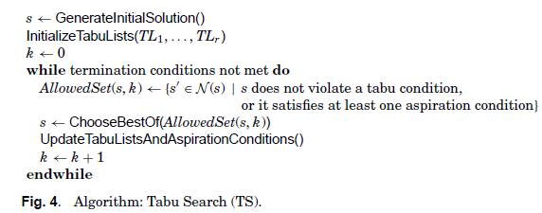
TABU SEARCH
Forbidding “attributes” may be overly restrictive
aspiration conditions are introduced as “wild-cards” for certain solutions, e.g., new incumbents are always accepted, even if they possess taboo attributes

Slide 63
GRASP
Greedy Randomized Adaptive Search Procedure
It is a general-purpose “construct and improve” framework
Provides some structure to the construction phase
Requires solution to be a combination of “solution elements”

Slide 64
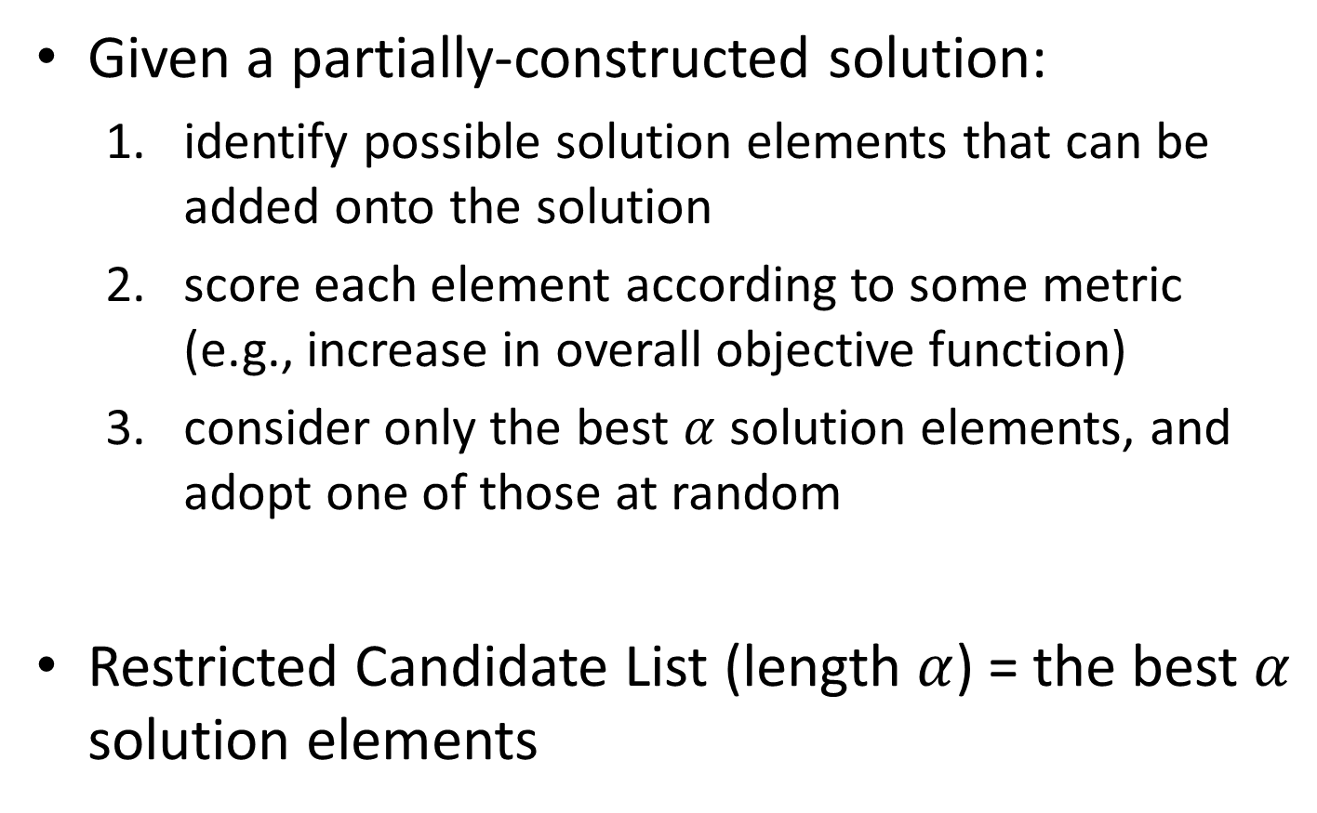
GRASP
Given a partially-constructed solution:
identify possible solution elements that can be added onto the solution
score each element according to some metric (e.g., increase in overall objective function)
consider only the best $α$ solution elements, and adopt one of those at random
Restricted Candidate List (length $α$) = the best $α$ solution elements

Slide 65
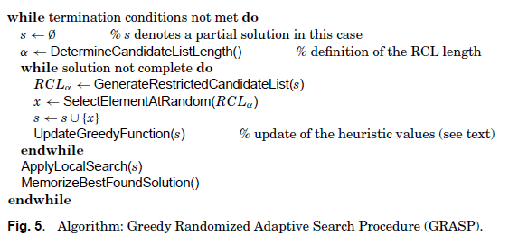
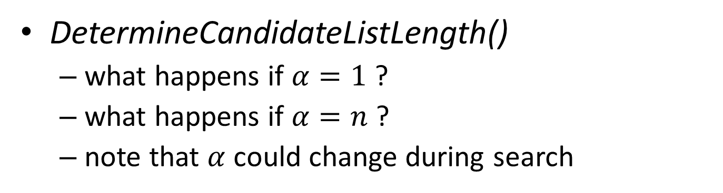
GRASP
DetermineCandidateListLength()
what happens if $α=1$ ?
what happens if $α=n$ ?
note that $α$ could change during search
greedy heuristic
completely random

Slide 66
GRASP
GenerateRestrictedCandidateList() may or may not exhaustively consider all options
UpdateGreedyFunction() scoring may be static or dynamic
static = scores assigned beforehand and do not change
dynamic = scores depend on current partial solution

Slide 67
GRASP
ApplyLocalSearch() could involve basic local search or some other metaheuristic (e.g., SA, TS)
it is important that the solution construction produces solutions from basins of attraction of different locally minimal solutions (sufficient level of diversification)

Slide 68
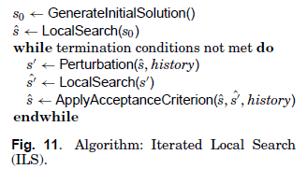
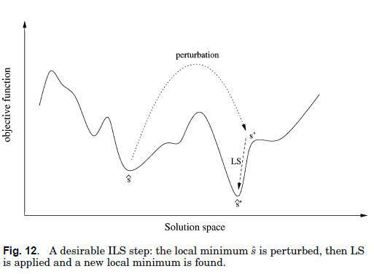
ITERATED LOCAL SEARCH
ILS is a general-purpose “multi-restart” local search framework
Provides structure in selection of next initial point
Perturbation() aspires that new initial point is
far enough to lead to a new local optimum
close enough to be better that a “random” pick

Slide 69
ITERATED LOCAL SEARCH
ILS is a general-purpose “multi-restart” local search framework
Provides structure in selection of next initial point
Perturbation() is non-deterministic (avoids cycling)
The “strength” of Perturbation() (i.e., how many solution feature changes are induced) varies along search process

Slide 70
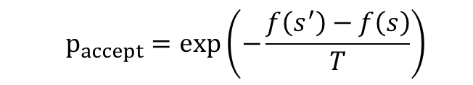
ITERATED LOCAL SEARCH
ILS is a general-purpose “multi-restart” local search framework
Provides structure in selection of next initial point
ApplyAcceptanceCriterion() is often some type of “annealing” criterion
$$p_{accept}=exp\left(−\frac{f\left(s^{′}\right)−f\left(s\right)}{T}\right)$$

Slide 71
ITERATED LOCAL SEARCH
ILS is a general-purpose “multi-restart” local search framework
Provides structure in selection of next initial point
What controls the balance between intensification and diversification?

Slide 72
ESCAPING LOCAL OPTIMA

Slide 73
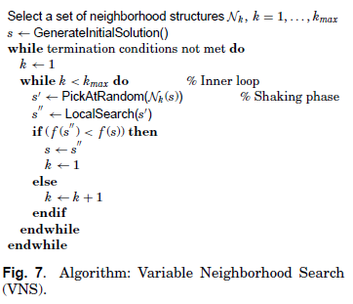
VARIABLE NEIGHBORHOOD SEARCH
VNS is a search strategy based on dynamically changing neighborhood structures
← solution quality →
← search coordinate →
primary neighborhood (small size)

Slide 74
VARIABLE NEIGHBORHOOD SEARCH
VNS is a search strategy based on dynamically changing neighborhood structures
← solution quality →
← search coordinate →
primary neighborhood (small size)
secondary neighborhood (large size)

Slide 75
VARIABLE NEIGHBORHOOD SEARCH
VNS is a search strategy based on dynamically changing neighborhood structures
← solution quality →
← search coordinate →
What controls the balance between intensification and diversification?
primary neighborhood (small size)
secondary neighborhood (large size)

Slide 76
GUIDED LOCAL SEARCH
Instead of dynamically changing search directions, GLS dynamically changes (augments) objective
Main idea is to make current solution vicinity increasingly unattractive

Slide 77
GUIDED LOCAL SEARCH
Instead of dynamically changing search directions, GLS dynamically changes (augments) objective
Main idea is to make current solution vicinity increasingly unattractive

Slide 78
GUIDED LOCAL SEARCH
Instead of dynamically changing search directions, GLS dynamically changes (augments) objective
Main idea is to make current solution vicinity increasingly unattractive

Slide 79
GUIDED LOCAL SEARCH
Instead of dynamically changing search directions, GLS dynamically changes (augments) objective
Main idea is to make current solution vicinity increasingly unattractive

Slide 80
GUIDED LOCAL SEARCH
Instead of dynamically changing search directions, GLS dynamically changes (augments) objective
Main idea is to make current solution vicinity increasingly unattractive

Slide 81
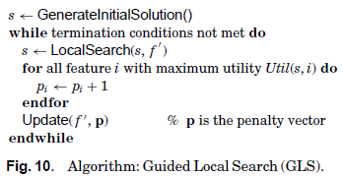
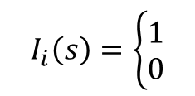

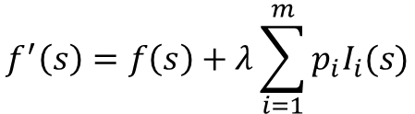
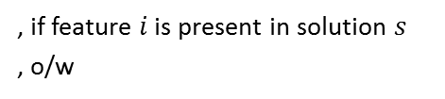
GUIDED LOCAL SEARCH
Instead of dynamically changing search directions, GLS dynamically changes (augments) objective
Main idea is to make current solution vicinity increasingly unattractive
$$Util\left(s,i\right)=I_{i}(s)\frac{c_{i}}{1+p_{i}}$$
any solution feature
(e.g., a particular solution component)
$$f^{′}\left(s\right)=f\left(s\right)+λ\sum_{i=1}^{m}{p_{i}I_{i}(s)}$$
$$I_{i}\left(s\right)=\left\{\begin{matrix}1 \\ 0\end{matrix}\right.$$
, if feature $i$ is present in solution $s$
, o/w

Slide 82
POPULATION-BASED METHODS

Slide 83
POPULATION-BASED METHODS
0th population

Slide 84
POPULATION-BASED METHODS
Get some new points

Slide 85
POPULATION-BASED METHODS
Drop some old points

Slide 86
POPULATION-BASED METHODS
1st population

Slide 87
POPULATION-BASED METHODS
2nd population

Slide 88
POPULATION-BASED METHODS
All points sampled
Again, optimum may or may not have been sampled
Typically, the incumbent always remains in the population, so need only focus on last generation

Slide 89
CLASSIFICATION #5
Population-based
(P-metaheuristics)
Evolutionary Computation
Evolutionary Programming (1962)
Evolutionary Strategies (1973)
Genetic Algorithms (1975)
Estimation of Distribution Algorithm (1996)
Swarm Intelligence
Ant Colony Optimization (1992)
Particle Swarm Optimization (1995)
Honey-Bees Mating (2005)
Differential Evolution (1995)
Adaptive Memory Programming (1997)
Scatter Search/Path Relinking (1999)

Slide 90
POPULATION-BASED METHODS
Populations may not necessarily constitute a collection of complete solutions; could instead be
collection of partial solutions
collection of solution attributes
Multiple approaches in selecting which individuals will constitute the new population
select all newly generated individuals
select only “elite” individuals
Very important to start with a diverse initial population
application of an S-metaheuristic may be counterproductive
sufficient randomization required
explicit criteria may be taken into account (e.g., maximize minimum distance among any two solutions in initial pool)

Slide 91
EVOLUTIONARY COMPUTATION
Populations evolve in “generations”
New individuals (offspring) are created by combining features of current individuals (parents);
typically two parents combine to give offspring
Individuals evolve using variation operators (e.g., “mutation”, “recombination”) acting directly on their solution representations
The next population consists of a mix of offspring and parents (“survivor selection” strategy)

Slide 92
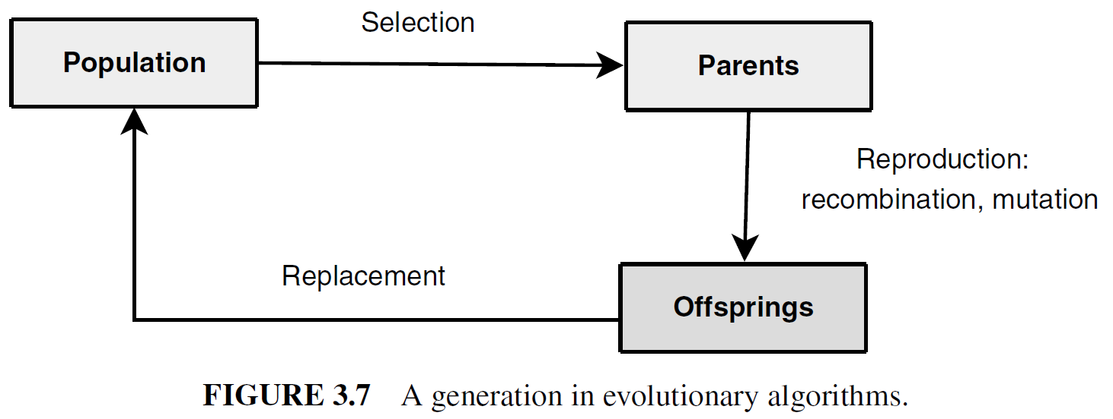
EVOLUTIONARY COMPUTATION

Slide 93
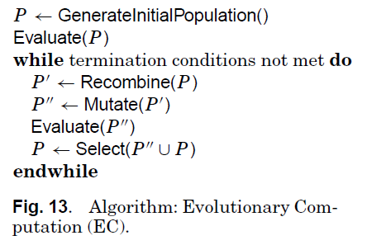
EVOLUTIONARY COMPUTATION

Slide 94
EVOLUTIONARY COMPUTATION
The population size is (almost always) fixed
Selection may involve multiple copies of a given parent individual
The best individual is (almost always) carried over to the next generation
Randomness plays a significant role in generating offspring (unlike other non-EC methods)
Solutions are often represented in compact and “easily mutable” form, e.g., bit-strings or integer permutations

Slide 95
EVOLUTIONARY COMPUTATION
0th population

Slide 96
EVOLUTIONARY COMPUTATION
N^{th} population

Slide 97
GENETIC ALGORITHM
Basic Evolutionary Computation Algorithm
Representation of individuals in binary code
(e.g., “01101” = 13, “11010” = 26)
Use of the “crossover” recombination operator
Mutation via “bit-flipping”
Offspring always survive
EXAMPLE

Slide 98
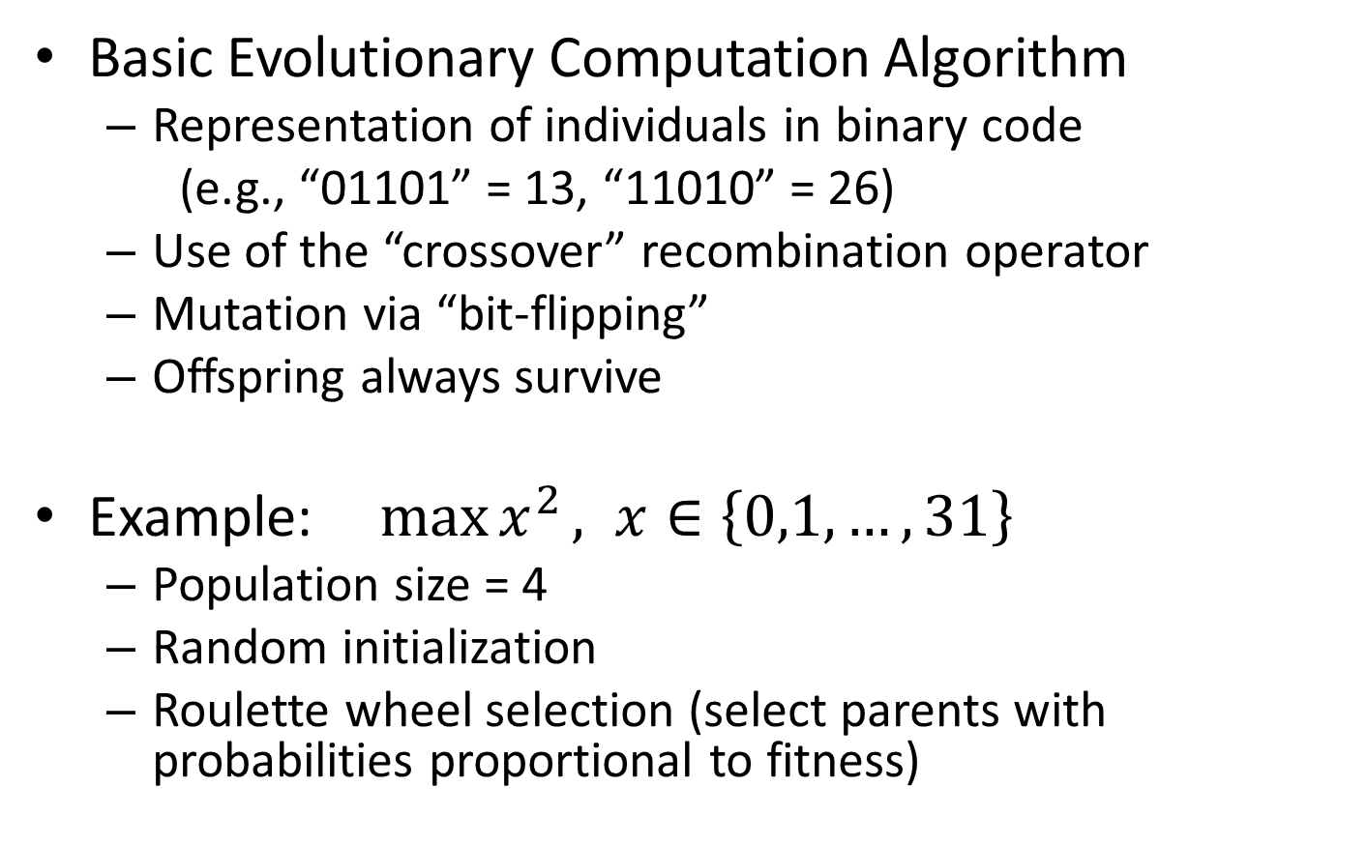
GENETIC ALGORITHM
Basic Evolutionary Computation Algorithm
Representation of individuals in binary code
(e.g., “01101” = 13, “11010” = 26)
Use of the “crossover” recombination operator
Mutation via “bit-flipping”
Offspring always survive
Example: $\max{x^{2}}, x∈\left\{0,1,…,31\right\}$
Population size = 4
Random initialization
Roulette wheel selection (select parents with probabilities proportional to fitness)

Slide 99
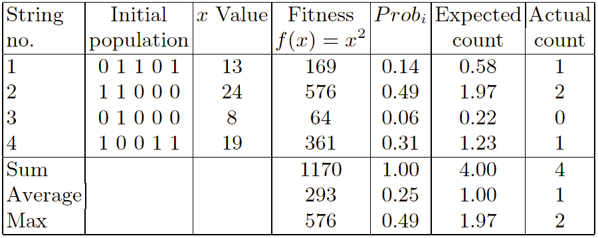

GENETIC ALGORITHM
Example: $\max{x^{2}}, x∈\left\{0,1,…,31\right\}$
Selection:

Slide 100
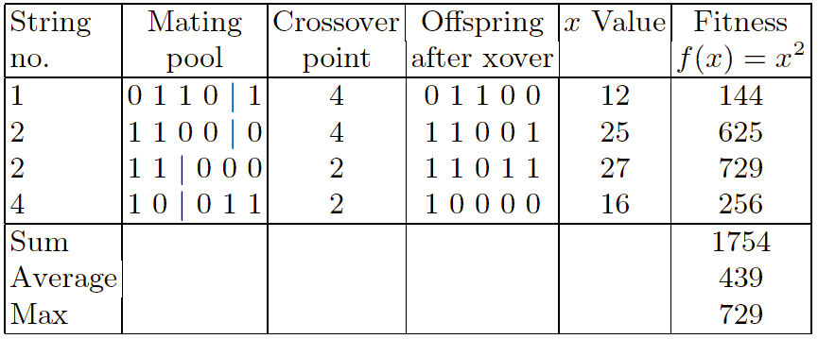
GENETIC ALGORITHM
Example: $\max{x^{2}}, x∈\left\{0,1,…,31\right\}$
Crossover:

Slide 101
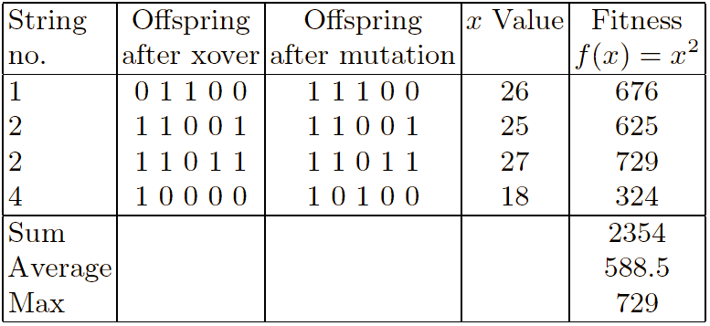


GENETIC ALGORITHM
Example: $\max{x^{2}}, x∈\left\{0,1,…,31\right\}$
Mutation:
$$28$$
$$20$$

Slide 102
Initial Population for TSP
(5,3,4,6,2)
(2,4,6,3,5)
(4,3,6,5,2)
(2,3,4,6,5)
(4,3,6,2,5)
(3,4,5,2,6)
(3,5,4,6,2)
(4,5,3,6,2)
(5,4,2,3,6)
(4,6,3,2,5)
(3,4,2,6,5)
(3,6,5,1,4)

Slide 103
Select Parents
(5,3,4,6,2)
(2,4,6,3,5)
(4,3,6,5,2)
(2,3,4,6,5)
(4,3,6,2,5)
(3,4,5,2,6)
(3,5,4,6,2)
(4,5,3,6,2)
(5,4,2,3,6)
(4,6,3,2,5)
(3,4,2,6,5)
(3,6,5,1,4)
Try to pick the better ones.

Slide 104
Create Off-Spring – 1 point
(5,3,4,6,2)
(2,4,6,3,5)
(4,3,6,5,2)
(2,3,4,6,5)
(4,3,6,2,5)
(3,4,5,2,6)
(3,5,4,6,2)
(4,5,3,6,2)
(5,4,2,3,6)
(4,6,3,2,5)
(3,4,2,6,5)
(3,6,5,1,4)
(3,4,5,6,2)

Slide 105
Create More Offspring
(5,3,4,6,2)
(2,4,6,3,5)
(4,3,6,5,2)
(2,3,4,6,5)
(4,3,6,2,5)
(3,4,5,2,6)
(3,5,4,6,2)
(4,5,3,6,2)
(5,4,2,3,6)
(4,6,3,2,5)
(3,4,2,6,5)
(3,6,5,1,4)
(3,4,5,6,2)
(5,4,2,6,3)

Slide 106
Mutate
(5,3,4,6,2)
(2,4,6,3,5)
(4,3,6,5,2)
(2,3,4,6,5)
(4,3,6,2,5)
(3,4,5,2,6)
(3,5,4,6,2)
(4,5,3,6,2)
(5,4,2,3,6)
(4,6,3,2,5)
(3,4,2,6,5)
(3,6,5,1,4)
(3,4,5,6,2)
(5,4,2,6,3)

Slide 107
Mutate
(5,3,4,6,2)
(2,4,6,3,5)
(4,3,6,5,2)
(2,3,4,6,5)
(2,3,6,4,5)
(3,4,5,2,6)
(3,5,4,6,2)
(4,5,3,6,2)
(5,4,2,3,6)
(4,6,3,2,5)
(3,4,2,6,5)
(3,6,5,1,4)
(3,4,5,6,2)
(5,4,2,6,3)

Slide 108
Eliminate
(5,3,4,6,2)
(2,4,6,3,5)
(4,3,6,5,2)
(2,3,4,6,5)
(2,3,6,4,5)
(3,4,5,2,6)
(3,5,4,6,2)
(4,5,3,6,2)
(5,4,2,3,6)
(4,6,3,2,5)
(3,4,2,6,5)
(3,6,5,1,4)
(3,4,5,6,2)
(5,4,2,6,3)
Tend to kill off the worst ones.

Slide 109
Integrate
(5,3,4,6,2)
(2,4,6,3,5)
(5,4,2,6,3)
(3,4,5,6,2)
(2,3,6,4,5)
(3,4,5,2,6)
(3,5,4,6,2)
(4,5,3,6,2)
(5,4,2,3,6)
(4,6,3,2,5)
(3,4,2,6,5)
(3,6,5,1,4)

Slide 110
Restart
(5,3,4,6,2)
(2,4,6,3,5)
(5,4,2,6,3)
(3,4,5,6,2)
(2,3,6,4,5)
(3,4,5,2,6)
(3,5,4,6,2)
(4,5,3,6,2)
(5,4,2,3,6)
(4,6,3,2,5)
(3,4,2,6,5)
(3,6,5,1,4)

Slide 111
TSP Example: 30 Cities

Slide 112
Solution _{i} (Distance = 941)

Slide 113
Solution _{j}(Distance = 800)

Slide 114
Solution _{k}(Distance = 652)

Slide 115
Best Solution (Distance = 420)

Slide 116
Overview of Performance

Slide 117
EVOLUTIONARY COMPUTATION
Intensification strategies:
Memetic Algorithms = use of local search procedures to improve each and every individual
Linkage Learning = use of advanced recombination operators instead of simplistic crossovers (e.g., one-bit) to combine “good” parts of individuals
Diversification strategies:
Mutation = basic operation; usually need more than that
Crowding/Preselection = eliminate offspring that are similar to current individuals
Fitness Sharing = reduce reproductive fitness of individuals that have common features with each other, encourage preservation of “unique” features

Slide 118
ANT COLONY OPTIMIZATION
Also a population-based method (i.e., maintains a collection of solutions or solution components)
Unlike EC methods, where individuals evolve separately, here the whole population participates in the construction of a shared memory, which is then used as a whole during recombination phase in order to generate the new population
In ACO, the shared memory is represented by the “pheromone matrix”
Dorigo M., Maniezzo V. and Colorni A. (1996), “Ant system: optimization by a colony of cooperating agents." IEEE Transactions on Systems, Man, and Cybernetics, Part B: Cybernetics, 26(1):29-41.

Slide 119
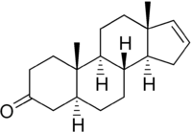
ANT COLONY OPTIMIZATION
Pheromone (anc. Greek): “to bear impetus”
Pheromone (biology): a chemical substance that an animal or insect produces in order to attract other animals or insects and especially a mate
Pheromone (chemistry):
(5S,8R,9S,10S,13R,14S) - 10, 13 – dimethyl - 1, 2, 4, 5, 6, 7, 8, 9, 11, 12, 14, 15 dodecahydrocyclopenta[a]phenanthren-3-one

Slide 120
ANT COLONY OPTIMIZATION
Ants prefer to walk in familiar territory/paths, where things are known to be safe
they excrete pheromone wherever they step into
they detect pheromone on the soil, and tend to go into high concentration levels
the pheromone goes away (evaporates) over time
In general, there are lots of ants
individual ant behavior is probabilistic drawn from a suitable distribution

Slide 121
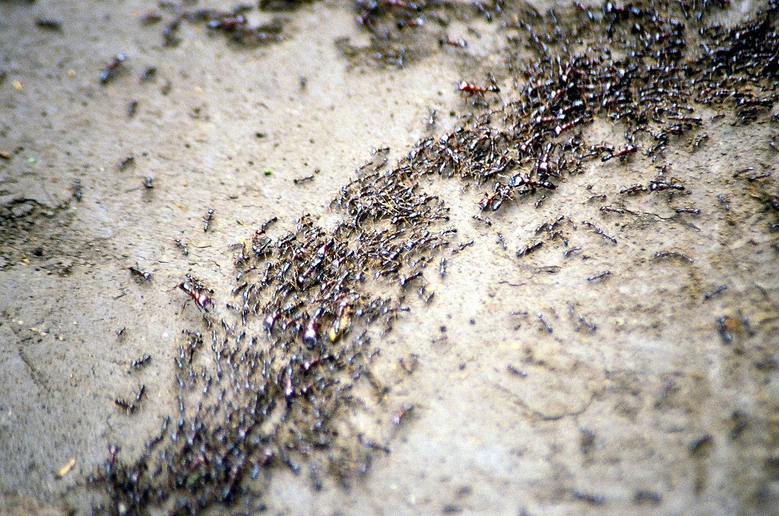
ANT COLONY OPTIMIZATION

Slide 122
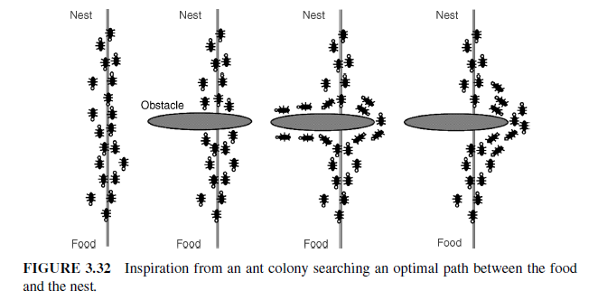
ANT COLONY OPTIMIZATION
Each possible solution component is associated with a level of pheromone, which goes up and down depending on the probability that the component is part of the final solution

Slide 123
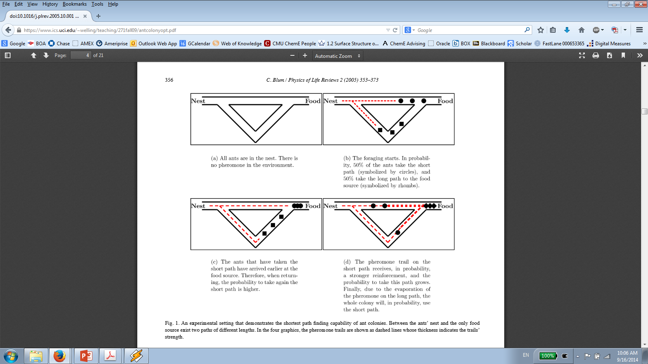
ANT COLONY OPTIMIZATION
Blum C. (2005), “Ant colony optimization: Introduction and recent trends." Physics of Life Reviews, 2:353-363.

Slide 124
ANT COLONY OPTIMIZATION
Ants are almost always artificial (do not use real ants!)
Each artificial ant represents a solution that is being incrementally constructed by adding opportunely defined solution components (i.e., according to a probabilistic transition rule)
only prerequisite is availability of a suitable construction heuristic
constraints are implicitly built into the construction heuristic (i.e., at every stage we only consider components that do not render the solution infeasible)
generalized methods may allow ants to realize infeasible solutions

Slide 125
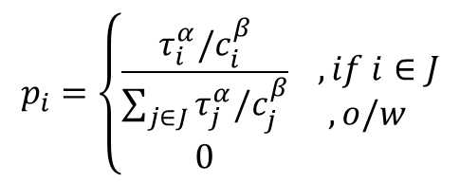

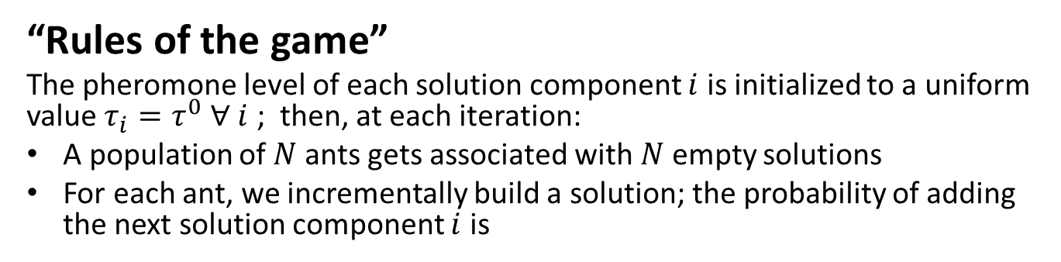

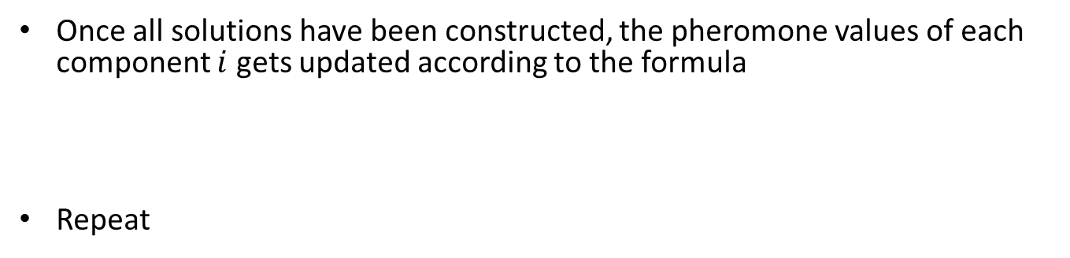
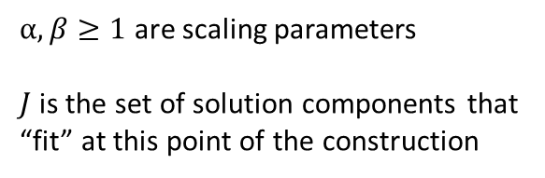
ANT COLONY OPTIMIZATION
“Rules of the game”
The pheromone level of each solution component $i$ is initialized to a uniform value $τ_{i}=τ^{0} ∀ i$ ; then, at each iteration:
A population of $N$ ants gets associated with $N$ empty solutions
For each ant, we incrementally build a solution; the probability of adding the next solution component $i$ is
$$p_{i}=\left\{\begin{matrix}\frac{τ_{i}^{α}/c_{i}^{β}}{\sum_{j∈J}{τ_{j}^{α}/c_{j}^{β}}} \\ 0\end{matrix}\right. \begin{matrix}, if i∈J \\ , o/w \end{matrix}$$
$α,β≥1$ are scaling parameters
$J$ is the set of solution components that “fit” at this point of the construction
Once all solutions have been constructed, the pheromone values of each component $i$ gets updated according to the formula
Repeat
$$τ_{i}←{\left(1−ρ\right) τ}_{i}+\frac{1}{N}\sum_{\begin{aligned}a=1: \\ i∈s_{a}\end{aligned}}^{N}{F(s_{a})}$$
$F(s_{a})$ is the solution quality function (high values for overall good solutions)
$ρ∈[0,1]$ is the evaporation rate

Slide 126
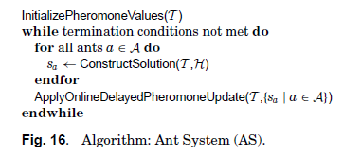
ANT COLONY OPTIMIZATION
EXAMPLE
ApplyOnlineDelayedPheromoneUpdate()
“Delayed” = after all ants have constructed solutions
“Online” = update based only on information derived from each and every individual ant
“Offline” (a.k.a., “Daemon updates”) = updates may be performed using some sort of “global” information (e.g., we may want to promote certain solutions by adding extra pheromone to their components

Slide 127
A highly efficient and effective metaheuristic algorithm for rich VRPs
Tarantilis C.D. Anagnostopoulou A. and Repoussis P.P. (2013). Adaptive Path Relinking for Vehicle Routing and Scheduling Problems with Product Returns. Transportation Science 47, 356-379.
Best ever reported results for the Capacitated VRP, the VRP with Time Windows and the VRP with Backhauls (comparison with more than 25 algorithms on large scale benchmark data set with up to 1000 customers)!

Slide 128
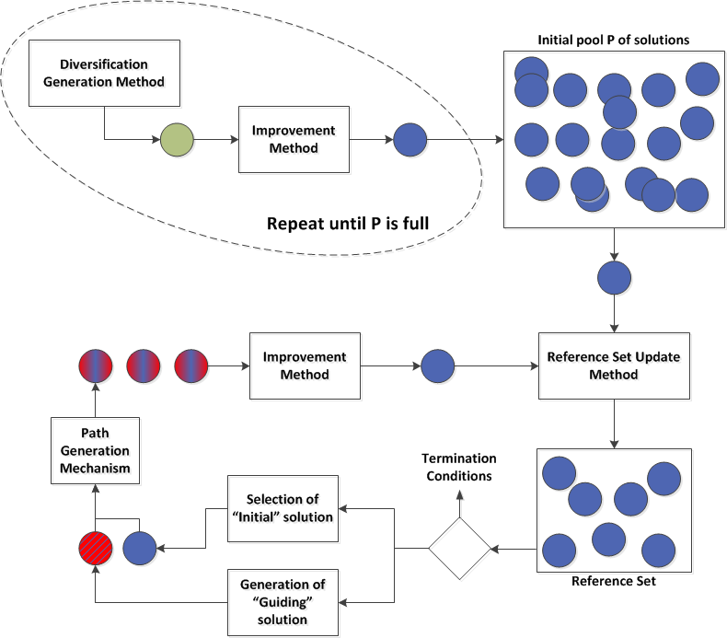

Slide 129
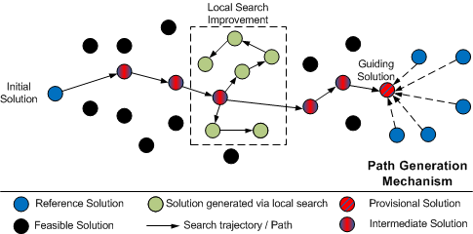

Slide 130
QUESTIONS?

